Slide 1
Chapter 14
Chemical Equilibrium

Slide 2
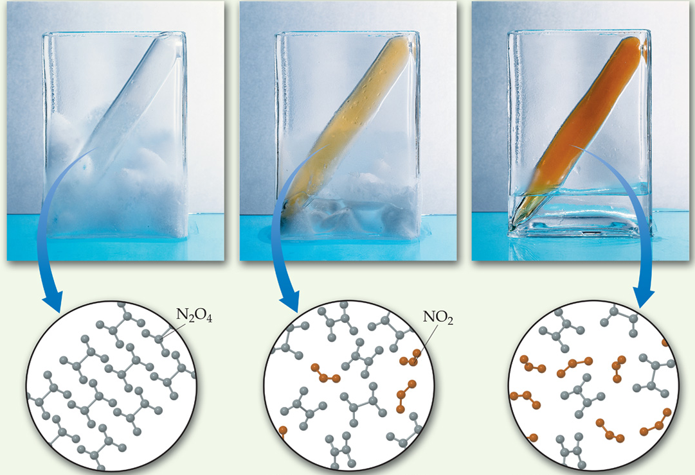
The Concept of Equilibrium
Chemical equilibrium occurs when a reaction and its reverse reaction proceed at the same rate.

Slide 3
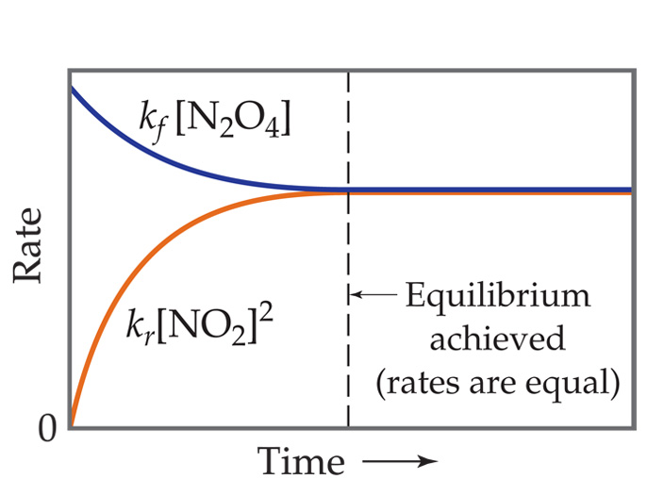
The Concept of Equilibrium
As a system approaches equilibrium, both the forward and reverse reactions are occurring.
At equilibrium, the forward and reverse reactions are proceeding at the same rate.
Once equilibrium is achieved, the amount of each reactant and product remains constant.

Slide 4
Depicting Equilibrium
In a system at equilibrium, both the forward and reverse reactions are being carried out; as a result, we write its equation with a double arrow
N₂O_{4 (g)}
2 NO_{2 (g)}

Slide 5
The Equilibrium Constant, K_{c}
Forward reaction:
  N₂O_{4 (g)} ⎯⎯→ 2 NO_{2 (g)}
Rate law:
  Rate = k_{f} [N₂O₄]
Reverse reaction:
  2 NO_{2 (g)} ⎯⎯→ N₂O_{4 (g)}
Rate law:
  Rate = k_{r} [NO₂]²

Slide 6
The Equilibrium Constant, K_{c}
Therefore, at equilibrium
Rate_{f} = Rate_{r}
k_{f} [N₂O₄] = k_{r} [NO₂]²
Rewriting this, it becomes
k_{f}
k_{r}
[NO₂]²
[N₂O₄]
k_{f}
k_{r}
[NO₂]²
[N₂O₄]
=
or
K_{c} =
=

Slide 7
The Equilibrium Constant, K_{c}
To generalize:
aA + bB
cC + dD
The equilibrium expression for this reaction would be
[C]^{c}[D]^{d}
[A]ª[B]^{b}
K_{c} =

Slide 8
The Equilibrium Constant FOR GASES ONLY
Because pressure is proportional to concentration for gases in a closed system, the equilibrium expression can also be written
(P_{C})^{c} (P_{D})^{d}
(P_{A})ª (P_{B})^{b}
K_{p} =

Slide 9
Relationship between K_{c} and K_{p}
PV = nRT
Rearranging it, we get
n
V
P = RT

Slide 10
Relationship between K_{c} and K_{p}
Plugging this into the expression for K_{p} for each substance, the relationship between K_{c} and K_{p} becomes:
K_{p} = K_{c} (RT)^{Δn}
Δn = (moles of gaseous product) − (moles of gaseous reactant)

Slide 11
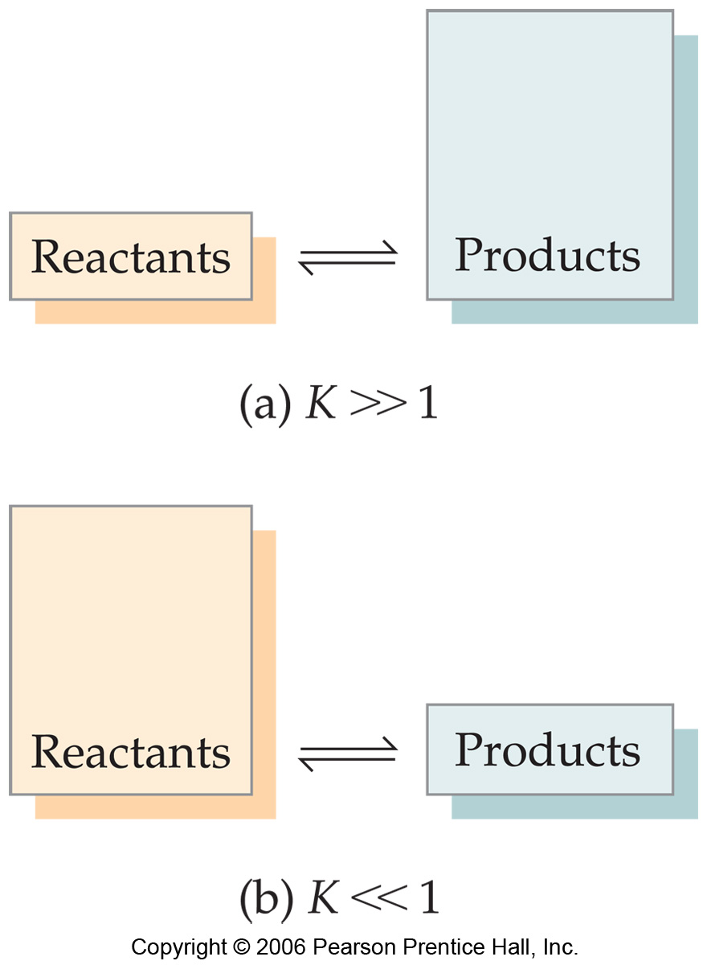
What Does the Value of K Mean?
If K >> 1, the reaction is product-favored; product predominates at equilibrium.
If K << 1, the reaction is reactant-favored; reactant predominates at equilibrium.

Slide 12
Manipulating Equilibrium Constants
The equilibrium constant of a reaction in the reverse reaction is the reciprocal of the equilibrium constant of the forward reaction.
[NO₂]²
[N₂O₄]
N₂O₄ (g)
2 NO₂ (g)
K_{c} = = 0.212 at 100°C
[N₂O₄]
[NO₂]²
1
0.212
2 NO₂ (g)
N₂O₄ (g)
=
K_{c} =
= 4.72 at 100°C

Slide 13
The Concentrations of Solids and Liquids Are Essentially Constant
Both can be obtained by dividing the density of the substance by its molar mass—and both of these are constants at constant temperature.
Therefore, the concentrations of solids and liquids do not appear in the equilibrium expression
PbCl_{2 (s)}
Pb²⁺ _{(aq)} + 2 Cl⁻_{(aq)}
K_{c} = [Pb²⁺] [Cl⁻]²

Slide 14
Equilibrium Calculations
A closed system initially containing
1.000 x 10⁻³ M H₂ and 2.000 x 10⁻³ M I₂
At 448°C is allowed to reach equilibrium. Analysis of the equilibrium mixture shows that the concentration of HI is 1.87 x 10⁻³ M. Calculate K_{c} at 448°C for the reaction taking place, which is
H_{2 (g)} + I_{2 (g)}
2 HI _{(g)}

Slide 15
What Do We Know?
 | [H₂], M | [I₂], M | [HI], M
Initially | 1.000 x 10⁻³ | 2.000 x 10⁻³ | 0
Change
At equilibrium |  |  | 1.87 x 10⁻³

Slide 16
[HI] Increases by 1.87 x 10⁻³ M
 | [H₂], M | [I₂], M | [HI], M
Initially | 1.000 x 10⁻³ | 2.000 x 10⁻³ | 0
Change |  |  | +1.87 x 10⁻³
At equilibrium |  |  | 1.87 x 10⁻³

Slide 17
Stoichiometry tells us [H₂] and [I₂] decrease by half as much
 | [H₂], M | [I₂], M | [HI], M
Initially | 1.000 x 10⁻³ | 2.000 x 10⁻³ | 0
Change | -9.35 x 10⁻⁴ | -9.35 x 10⁻⁴ | +1.87 x 10⁻³
At equilibrium |  |  | 1.87 x 10⁻³

Slide 18
We can now calculate the equilibrium concentrations of all three compounds…
 | [H₂], M | [I₂], M | [HI], M
Initially | 1.000 x 10⁻³ | 2.000 x 10⁻³ | 0
Change | -9.35 x 10⁻⁴ | -9.35 x 10⁻⁴ | +1.87 x 10⁻³
At equilibrium | 6.5 x 10⁻⁵ | 1.065 x 10⁻³ | 1.87 x 10⁻³

Slide 19
…and, therefore, the equilibrium constant
[HI]²
[H₂] [I₂]
K_{c} =
(1.87 x 10⁻³)²
(6.5 x 10⁻⁵)(1.065 x 10⁻³)
=
= 51

Slide 20
The Reaction Quotient (Q)
To calculate Q, one substitutes the initial concentrations on reactants and products into the equilibrium expression.
Q gives the same ratio the equilibrium expression gives, but for a system that is not at equilibrium.

Slide 21
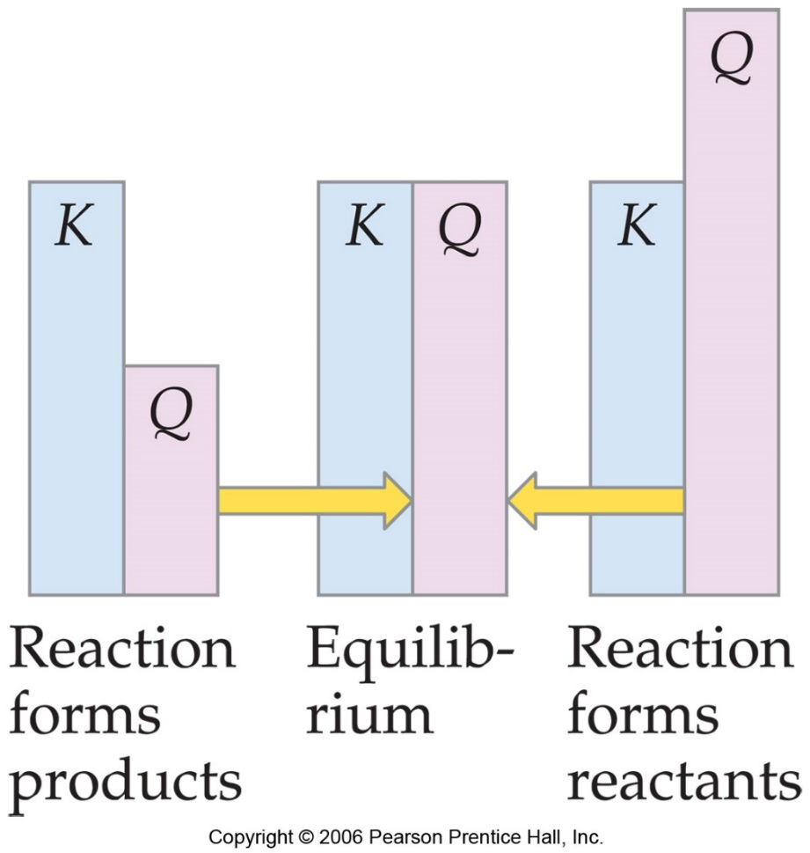
If Q = K,
the system is at equilibrium.

Slide 22
If Q > K,
there is too much product and the equilibrium shifts to the left.

Slide 23
If Q < K,
there is too much reactant, and the equilibrium shifts to the right.

Slide 24
Le Châtelier’s Principle

Slide 25
Le Châtelier’s Principle
“If a system at equilibrium is disturbed by a change in temperature, pressure, or the concentration of one of the components, the system will shift its equilibrium position so as to counteract the effect of the disturbance.”

Slide 26
LeChatelier Translated:
When you take something away from a system at equilibrium, the system shifts in such a way as to replace what you’ve taken away.
When you add something to a system at equilibrium, the system shifts in such a way as to use up what you’ve added.

Slide 27
Effect of Concentration of Reactants
Adding reactant shifts the reaction toward the products. Why?
Stress: Increasing reactants
Relief: Decreasing reactants
Shift: to the right (products)

Slide 28
Effect of Concentration of Products
Adding products shifts the reaction toward the reactants. Why?
Stress: Increasing products
Relief: Decreasing products
Shift: to the left (reactants)

Slide 29
Effect of Temperature
Increasing the temperature causes the equilibrium to shift in the direction that absorbs heat.
Why?
Stress: Increase in Temp
Relief: Decrease in Temp
Shift: Towards the left

Slide 30
Effect of Pressure
Affects gases only
For unequal number of moles of reactants and products, if pressure is increased, the equilibrium will shift to reduce the number of particles
For equal number of moles of reactants and products, no shift occurs.

Slide 31
Ex: Effect of Pressure
  2NO₂ (g) N₂O₄ (g)
  Stress: increasing the pressure
  Relief: decreasing the pressure
  Shift: to the right (side of less molecules…lower coefficient side)

Slide 32
Addition of a Catalyst
This does not affect an equilibrium
A catalyst speeds both forward and reverse reactions (by lowering the activation energy)
It allows us to get to equilibrium faster, but it does not alter equilibrium concentrations

